Slide 1
Destinations Deep Dive
Presented by Danny Miller – Principal Enterprise Architect

Slide 2
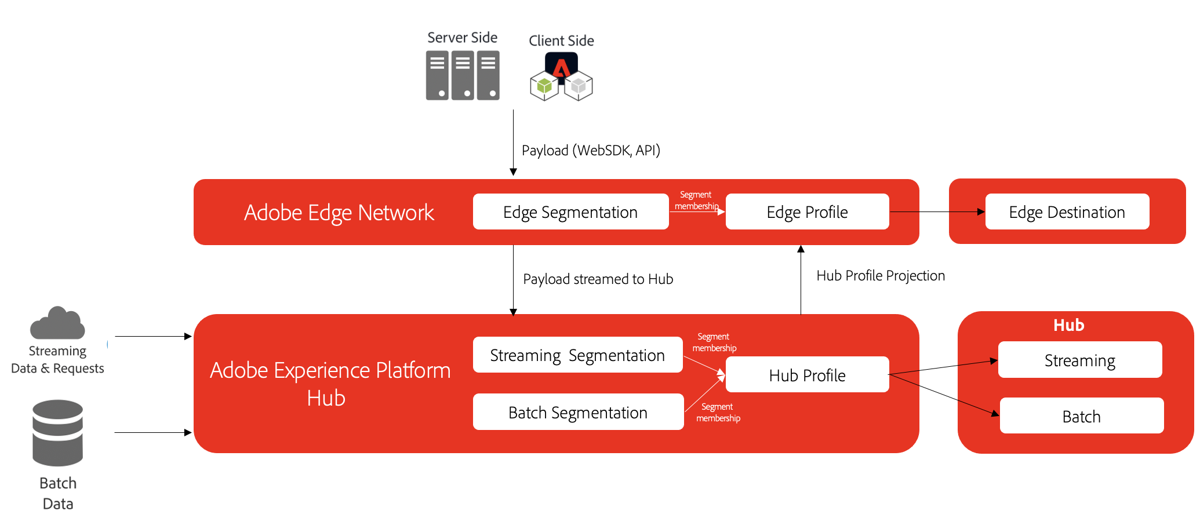
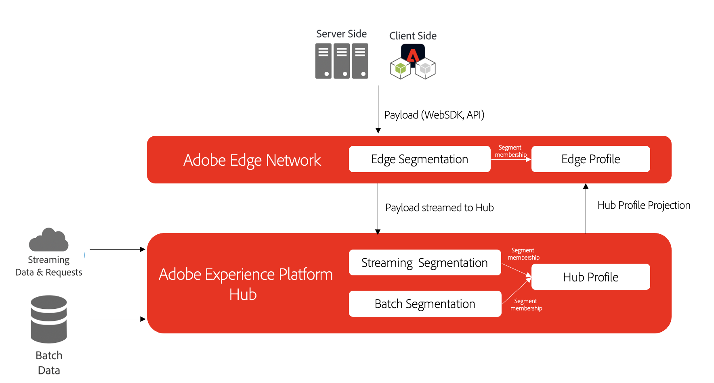
Objectives

Slide 3
Agenda
1
Overview
2
Workflow
3
Management & Analysis

Slide 4
Overview

Slide 5
Segmentation Types & Tradeoffs
3 Types of Segmentation
Fast
Edge Simple Questions Hit Level Only Next-page personalization
Same page personalization
Stream Moderately Complex Questions Short Look-back Windows
Near Real-time Results
Next session personalization
Retargeting/suppression via paid/social media
Email journey orchestration
Evaluation Speed
Batch Complex Questions Long Look-back Windows Latent Results
Slow
Low
Segment Definition Complexity
High

Slide 6
Use Case Recap
Use Case | Business Requirement | Technical Requirement | Segmentation Definition Complexity | Desired Evaluation Speed | Segmentation Type
Social Media Activation - Nurturing Warm Audiences | Nurture prospects through FB post promotions that outline the features of iPhone 13 and Pixel 6. FB has wide reach and FB posts are a great medium to share information. | Activate all profiles who have visited an iPhone 13 product page and no order exists for a for an iPhone 13 or do not have an active iPhone 13 | Moderate | Minutes | Streaming
Unlock New Opportunities - Cross Sell | Reach out to users that are showing a high usage (20GB+ monthly) in the last 6 months. We also want to make them an offer – a 20% discount on extending the phone contract while upgrading to the new plan. | Find all customers who have a total billing data usage in the last 6 months >140GB, a rolling 6 month avg. monthly data usage of >=20GB and they do not have an ultimate phone plan. Activate into Facebook / Google and Direct Mail channels. | High | Hours | Batch

Slide 7
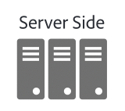

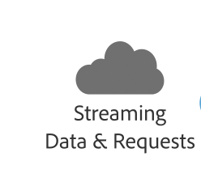
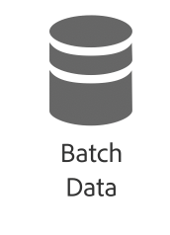
High Level Architecture
Payload (WebSDK, API)
Adobe Edge Network
Edge Segmentation
Segment
membership
Edge Profile
Edge Destination
Payload streamed to Hub
Hub Profile Projection
Adobe Experience Platform
Hub
Hub
Streaming Segmentation
Segment
membership
Streaming
Hub Profile
Batch Segmentation
Segment
membership
Batch

Slide 8

Key Concepts
Activation : send data to another system outside of Adobe Experience Platform.
What data can be sent?
Raw events (Extensions)
Use serve side forwarding to send raw event data
Real-Time Customer Profile Data (Connections)
Identities, attributes for a collection of segments
What data cannot be sent
Lookup values cannot be exported
Events cannot be exported
Arrays, objects, cannot be exported

Slide 9
Key Concept: Segment Evaluation Type
A streaming destination will activate on any changes (qualification, disqualification) as they happen in segment membership upstream
It may be unavoidable but to map a batch segment to a streaming destination
A batch destination will activate on any changes (qualification, disqualification) on schedule in segment membership upstream
Streaming segment can be mapped to a batch destination
Data sent can be full or incremental (since last activation) for each segment in the connection

Slide 10
Workflow

Slide 11
Workflow
Schedule applies
to Batch
Destinations
Management & Analysis
Schedule & Activate
Choose a Destination
Setup Account for a Destination
Create Connection
Choose Segments
Governance Policy
Choose Attributes & Identities
Browse the Catalog
Credentials & Configuration
Name, Description
All segments regardless of evaluation type
Block Segments where attributes do not meet governance policy criteria
Common to all segments

Slide 12
Management & Analysis

Slide 13
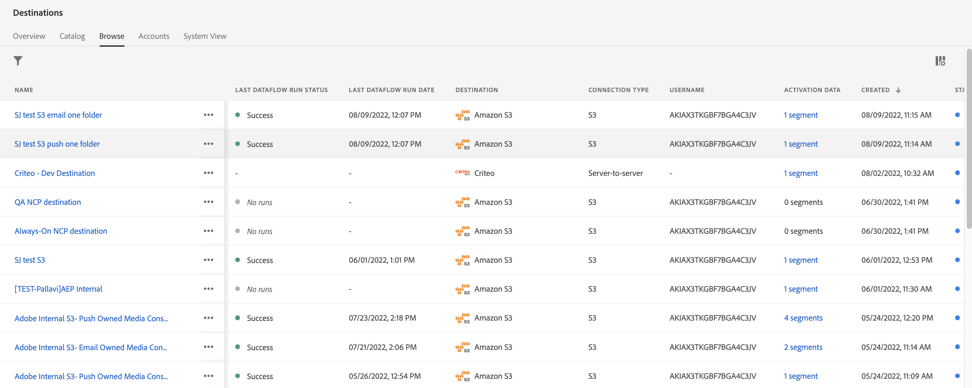
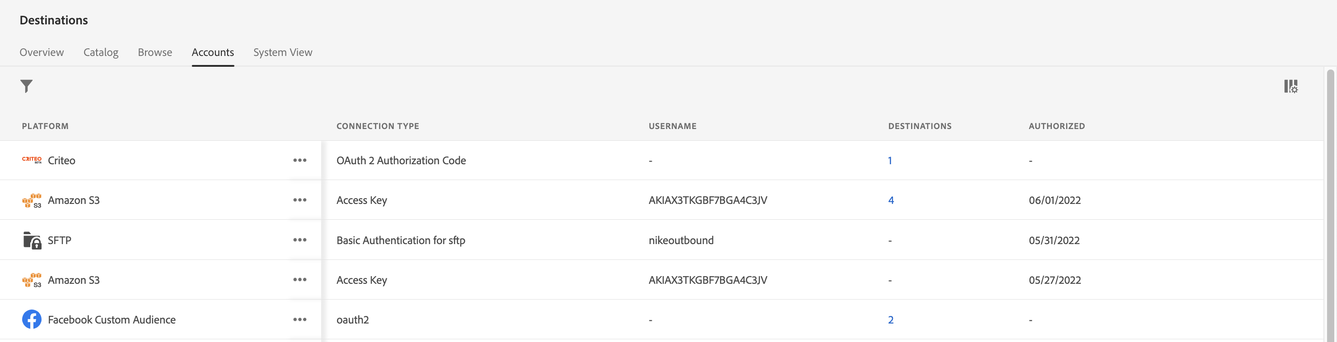
Destination Browse & Accounts
Browse
Accounts

Slide 14
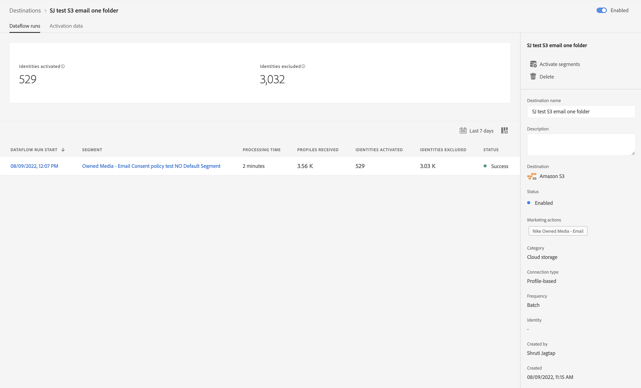
Destination Detail
Similar to what you see in Source Connections

Slide 15
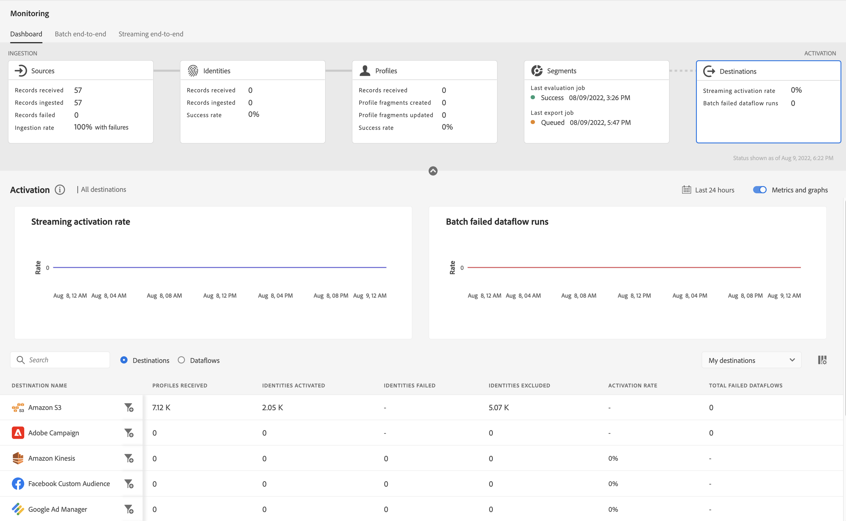
Destination Monitoring

Slide 16
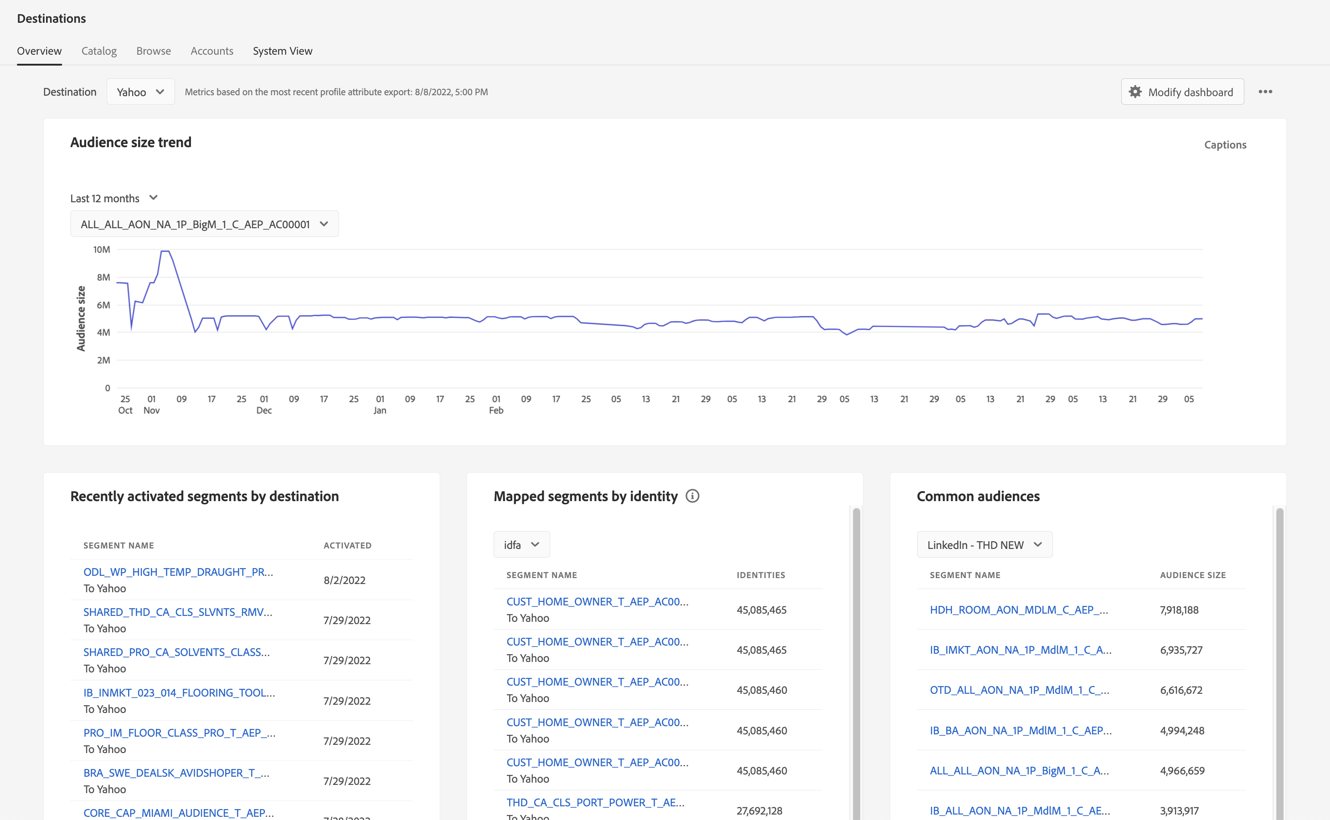
Destination Overview: Daily Report

Slide 18
Key Concept
Edge | Streaming | Batch
Personalization (Adobe Target, Custom Personalization Destination) | Social Media (FB, Twitter,, Linkedin, Snap, Pinterest), Advertising (Google Ads/Ad Manager/Display+Video 360, Bing, The Trade Desk) Email Marketing (Marketo Engage) CRM (Salesforce) Mobile Engagement (Airship Tags) VoC (Medallia) Cloud Storage (AWS Kinesis, Azure EventHub) Mobile Engagement (Braze, Airship Attributes) Personalization (Pega Decisioning Hub) HTTP API | Email Marketing (Salsforce Marketing Cloud, Sendgrid, Adobe Campaign, Oracle Eloqua+Responsys) Cloud Storage (S3, Azure Blob Storage)

